Slide 1
JavaScript
Ashish Jain / 9888 570 759 / ashishjain1547@gmail.com

Slide 2
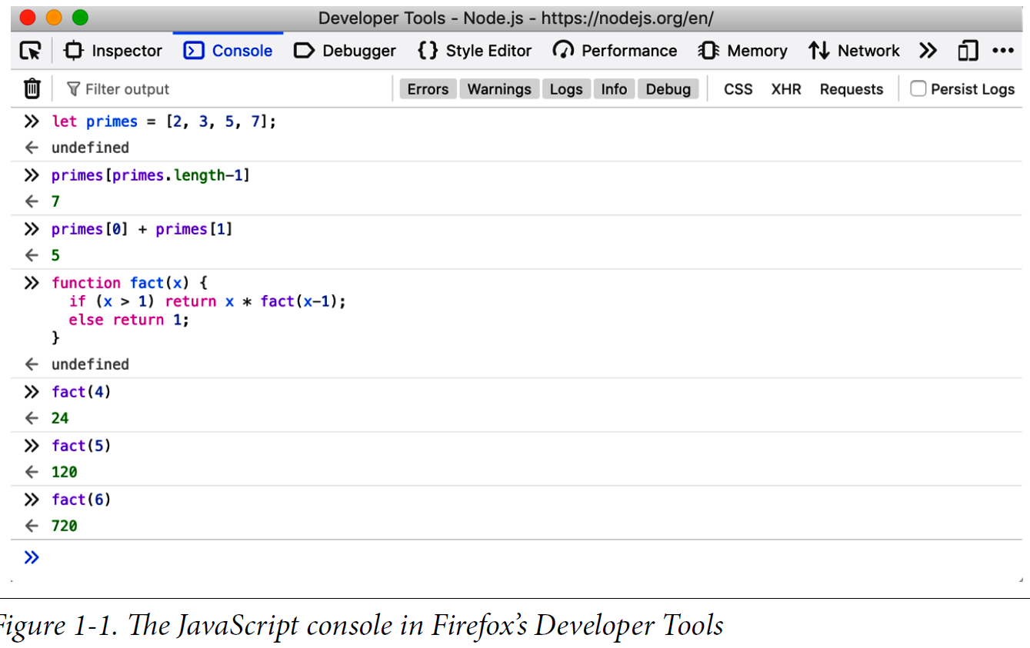
Where to run the JavaScript code? Option 1:

Slide 3
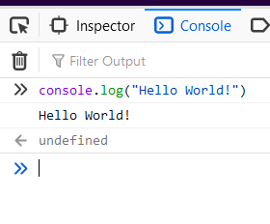
PRINTING SOMETHING:
The Hello World Program:
console.log("Hello World!");

Slide 4
Variable Declaration in JavaScript
// Values can be assigned to variables with an = sign
x = 0; // Now the variable x has the value 0
x // => 0: A variable evaluates to its value.
// JavaScript supports several types of values
x = 1; // Numbers.
x = 0.01; // Numbers can be integers or reals.
x = "hello world"; // Strings of text in quotation marks.
x = 'JavaScript'; // Single quote marks also delimit strings.
x = true; // A Boolean value.
x = false; // The other Boolean value.
x = null; // Null is a special value that means "no value."
x = undefined; // Undefined is another special value like null.

Slide 5
Object Declaration in JavaScript
JavaScript's most important datatype is the object.
An object is a collection of name/value pairs, or a string to value map.
let book = { // Objects are enclosed in curly braces.
topic: "JavaScript", // The property "topic" has value "JavaScript."
edition: 7 // The property "edition" has value 7
}; // The curly brace marks the end of the object.
// Access the properties of an object with . or []:
book.topic // => "JavaScript"
book["edition"] // => 7: another way to access property values.
book.author = "Flanagan"; // Create new properties by assignment.
book.contents = {}; // {} is an empty object with no properties.
// Conditionally access properties with ?. (ES2020):
book.contents?.ch01?.sect1 // => undefined: book.contents has no ch01 property.

Slide 6
Arrays in JavaScript (An Overview)
JavaScript also supports arrays (numerically indexed lists) of values:
let primes = [2, 3, 5, 7]; // An array of 4 values, delimited with [ and ].
primes[0] // => 2: the first element (index 0) of the array.
primes.length // => 4: how many elements in the array.
primes[primes.length-1] // => 7: the last element of the array.
primes[4] = 9; // Add a new element by assignment.
primes[4] = 11; // Or alter an existing element by assignment.
let empty = []; // [] is an empty array with no elements.
empty.length // => 0
// Arrays and objects can hold other arrays and objects:
let points = [ // An array with 2 elements.
{x: 0, y: 0}, // Each element is an object.
{x: 1, y: 1}
];
let data = { // An object with 2 properties
trial1: [[1,2], [3,4]], // The value of each property is an array.
trial2: [[2,3], [4,5]] // The elements of the arrays are arrays.
};

Slide 7
// Operators act on values (the operands) to produce a new value.
// Arithmetic operators are some of the simplest:
3 + 2 // => 5: addition
3 - 2 // => 1: subtraction
3 * 2 // => 6: multiplication
3 / 2 // => 1.5: division
points[1].x - points[0].x // => 1: more complicated operands also work
"3" + "2" // => "32": + adds numbers, concatenates strings

Slide 8
// JavaScript defines some shorthand arithmetic operators
let count = 0; // Define a variable
count++; // Increment the variable
count--; // Decrement the variable
count += 2; // Add 2: same as count = count + 2;
count *= 3; // Multiply by 3: same as count = count * 3;
count // => 6: variable names are expressions, too.

Slide 9
Equality and relational operators test whether two values are equal, unequal, less than, greater than, and so on. They evaluate to true or false.
let x = 2, y = 3; // These = signs are assignment, not equality tests
x === y // => false: equality
x !== y // => true: inequality
x < y // => true: less-than
x <= y // => true: less-than or equal
x > y // => false: greater-than
x >= y // => false: greater-than or equal
"two" === "three" // => false: the two strings are different
"two" > "three" // => true: "tw" is alphabetically greater than "th"
false === (x > y) // => true: false is equal to false
// Logical operators combine or invert boolean values
(x === 2) && (y === 3) // => true: both comparisons are true. && is AND
(x > 3) || (y < 3) // => false: neither comparison is true. || is OR
!(x === y) // => true: ! inverts a boolean value

